Slide 2
What are we doing here?
A strategic initiative is an action-oriented and measurable goal set to achieve specific objectives and a long-term vision for improvement. The success of the set strategic initiatives depends on deciding the goals you want to accomplish and what the bottom line means to your business. You can achieve the desired outcomes by determining the actions required for success.

Slide 3
Time Poverty
Best in class service provider
Efficient available Resources
Leverage

Slide 4
Conclusions from talking to members
You are running very successful businesses
You are seeking leverage for your own businesses from your Cerrado membership
You have more money than you have time…but you need to invest wisely and get an ROI that you can identify – Let’s redefine resources and agree how to budget for new solutions
The services needed in each of your businesses are common between firms, and some of you already have sharable services – Let’s clarify that!
There are real pressures in your business to create more efficiency especially in data related processes- Let’s clarify current state of external and custom solutions;
You agreed to 3 strategic initiatives for 2024 to bring value to all members – Let’s get a goal, budget, expected outcomes, and a member advisor for each of these initiatives

Slide 5
TCG Strategic initiatives 2024
TECHNOLOGY
BRAND
NEW PRODUCTS & SERVICES
Well-defined goals
Budget
Timelines and milestones
Practical steps to achieve desired goals
Measuring to gauge the progress
Member Steering Committee
TODAY WE WILL FRAME OUT A STRATEGY FOR EACH INITIATIVE

Slide 6
Reset the deck on resources
Executive director role
Funding sources

Slide 7
Inventory existing resources
KEY:
X = Service Available to share with Cerrado Group members
C = Currently have outside users of this service
KEY: X = Service Available to share with Cerrado Group members C = Currently have outside users of this service | TCG Member | Parrish Pettey | Trina Gross | Mike Mulka | Pat Shelton | Jordan Cross | Jill Dennis Nick Zapf | Bob Carroll | Stephanie Copner Tom Tsaris | Joe Burt | Debbie Zimmer | Amy Haddan Kim Hansz | Matt Slyter | Forrest Knowles | Leslie O'Bryan
 |  | AGB | Acuff & Associates | Aim Point Pension | Benefit Plans Plus | Cross Plans | Dunbar Bender and Zapf | MAP Retirement | Nexus Administrators | Pension Plan Specialists | Qualified Pension Services | The Benefit Advantage | TSC 401(k) | QRPS | Benefit Administrators
Services Available to Share
Actuarial
ESOP
Non-Qual
316
Recordkeeping
MEP
PEP
Group of Plans
Cash Balance
Payroll Integration
Employee Outsourcing
IRA Rollovers
Onboarding /Training
Trust Services
Tax Consulting- CPA -
DB

Slide 8
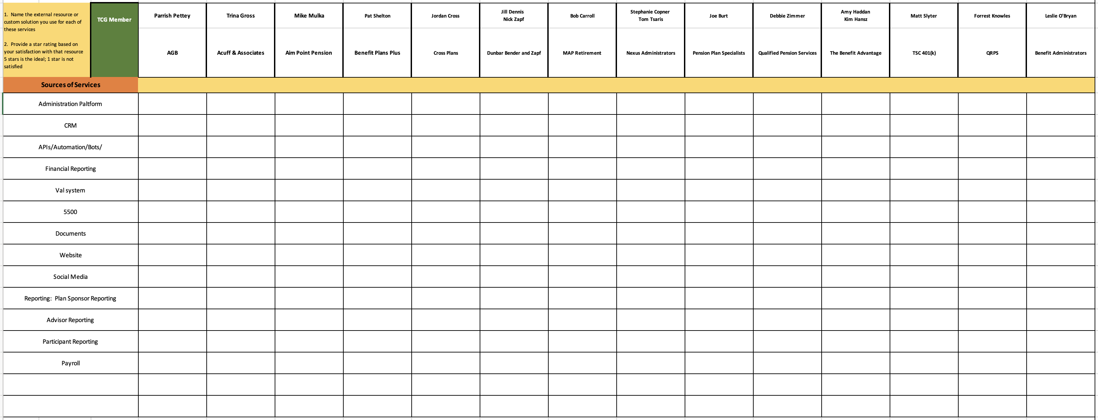
Inventory services-service providers
1. Name the external resource or custom solution you use for each of these services
Provide a star rating based on your satisfaction with that resource
5 stars is the ideal; 1 star is not satisfied

Slide 9
TCG Strategic initiatives 2024
1. TECHNOLOGY
Develop the next generation of efficient service delivery through data automation; reduce labor costs and improve quality
Well-defined goals
Budget
Timelines and milestones
Practical steps to achieve desired goals
Measuring to gauge the progress
Member Steering Committee

Slide 10
TCG Strategic initiatives 2024
2. BRANDING
Create and implement target messaging and social media campaign to boost brand awareness
Well-defined goals
Budgets
Timelines and milestones
Practical steps to achieve desired goals
Measuring to gauge the progress
"Why Cerrado matters to you" stories need to be developed for a variety of audiences:
Create "Why Cerrado" member website messaging + a link to Cerrado Resources,
Why Cerrado staff messaging
Why Cerrado advisor messaging
Why Cerrado record keeper sales team messaging and outreach
Why Cerrado CPA messaging
Cerrado blog/newsletter
Social media strategy
Steering Committee

Slide 11
TCG Strategic initiatives 2024
3. NEW PRODUCTS
Increase service offerings and products
Well-defined goals
Budget
Timelines and milestones
Practical steps to achieve desired goals
Measuring to gauge the progress
Member Steering Committee
Payroll integration

